Slide 1
NN and ML Lab

Slide 2
What is Exploratory Data Analysis?
Exploratory Data Analysis (EDA) is an important step in data science and data analytics as it visualize data to understand its main features, find and discover how different parts of the data are connected.

Slide 3
Why Exploratory Data Analysis Important?
Helps to understand dataset
Helps to identify hidden patterns and relationship between different data points
Allows to identify errors or unusual data points (outliers)
Help us to identify most important feature
Help us choosing best modeling techniques

Slide 4
Types of Exploratory Data Analysis?
Univariate Analysis
Bivariate Analysis
Multivariate Analysis

Slide 5
What is Univariate Analysis?
The main purpose of univariate analysis is to describe the data and find patterns that exist within it.
it doesn’t deal with causes or relationships
Stem-and-leaf plots, which show all data values and the shape of the distribution.
Histograms, a bar plot in which each bar represents the frequency (count) or proportion (count/total count) of cases for a range of values.
Box plots, which graphically depict the five-number summary of minimum, first quartile, median, third quartile, and maximum.

Slide 6
Univariate Data Analysis
Univariate analysis focuses on studying one variable to understand its characteristics
It helps to describe data and find patterns within a single feature.
Various common methods like histograms are used to show data distribution, box plots to detect outliers and understand data spread and bar charts for categorical data.
Summary statistics like mean, median, mode, variance and standard deviation helps in describing the central tendency and spread of the data

Slide 7
Bi-variate Analysis
Bivariate Analysis focuses on identifying relationship between two variables to find connections, correlations and dependencies
It helps to understand how two variables interact with each other.

Slide 8
Bivariate analysis techniques
Scatter Plots
Correlation coefficient
Cross tabulation or contingency tables
Line graph
Covariance

Slide 9
Scatter Plot
These visualizations plot person facts points as dots on a graph, with one variable represented on each axis.
Scatter plots which visualize the relationship between two continuous variables.

Slide 10
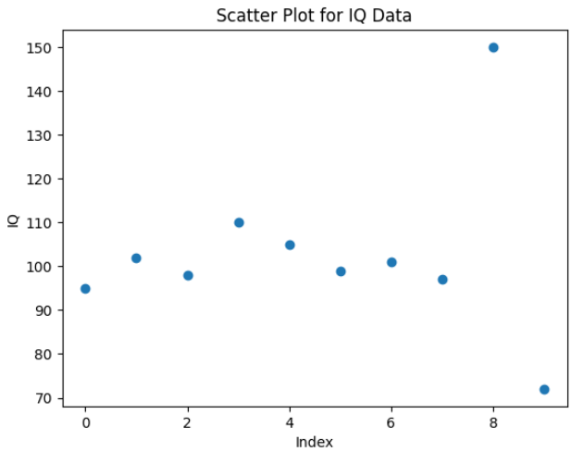
Scatter Plot Cont..
This scatter plot shows most IQ values clustered around 95–110 while the points near 72 and 150 stand out clearly as outliers compared to the rest of the data.

Slide 11
Correlation coefficient
Correlation coefficient measures how strongly two variables are related which commonly use Pearson's correlation for linear relationships.

Slide 12
Cross Tabulation
Cross-tabulation or contingency tables shows the frequency distribution of two categorical variables and help to understand their relationship.

Slide 13
Line Graph
Line graphs are useful for comparing two variables over time in time series data to identify trends or patterns.

Slide 14
Covariance
Covariance measures how two variables change together but it is paired with the correlation coefficient for a clearer and more standardized understanding of the relationship.

Slide 15
Multivariate Analysis
Multivariate Analysis identify relationships between two or more variables in the dataset and aims to understand how variables interact with one another which is important for statistical modeling techniques.

Slide 16
Multivariate Analysis Techniques
Pair Plot
Principal Component Analysis
Spatial Analysis
Time Series Analysis

Slide 17
Pair Plot
shows the relationships between multiple variables at once and helps in understanding how they interact

Slide 18
Principal Component Analysis
Reduces the complexity of large datasets by simplifying them while keeping the most important information
It works by calculating the covariance matrix of the features and finding its eigenvectors and eigenvalues. The top k eigenvectors with the largest eigenvalues define the new axes that capture the most variance in the data.
By projecting the original data onto these axes, PCA reduces the number of features while retaining as much information as possible. It’s fast, robust and especially effective when the dataset has linearly correlated features. However, it cannot capture complex non linear relationships.

Slide 19
Can one feature belong to multiple component?
Yes, absolutely. In fact, mathematically, every single feature contributes to every single principal component.Think of a Principal Component (PC) as a recipe. To make PC1, you might need a lot of "Feature A," a little bit of "Feature B," and almost no "Feature C." To make PC2, you might need a lot of "Feature C" but also a medium amount of "Feature A."

Slide 20
Classification Report Parameters
Precision
Recall (Sensitivity)
F1-Score
Support
Averaging Metrics (The Bottom Rows)

Slide 21
Precision
The "Quality" Metric. Precision answers the question: “Of all the instances the model predicted as positive, how many were actually positive?”
High Precision: Means the model doesn't label many negative samples as positive (low "False Positive" rate).
Formula:
  Precision = True Positive / (True Positives + False Positive)

Slide 22
Recall (Sensitivity)
The "Quantity" Metric. Recall answers the question: “Of all the instances that were actually positive, how many did the model identify?”
High Recall: Means the model is good at finding all the positive cases (low "False Negative" rate).
Formula:
  Recall = True Positives / (True Positives + False Negatives)

Slide 23
F1-Score
The "Balance" Metric.The F1-Score is the harmonic mean of Precision and Recall. It is particularly useful when you have an imbalanced dataset (e.g., 95% of your data is Class A and 5% is Class B).
It penalizes extreme values. If your Precision is $1.0$ but your Recall is $0.0$, your F1-Score will be $0$.
Formula:
  F1= 2 * (Precision * Recall) / (Precision + Recall)

Slide 24
Support
The "Reality Check" Metric. Support is simply the number of actual occurrences of the class in your specified dataset. It doesn't tell you about model performance; it tells you how much data you have for that class.
If the support for one class is 10 and another is 1,000, your metrics for the smaller class might not be statistically significant.

Slide 25
Averaging Metrics (The Bottom Rows)
Accuracy
  The fraction of total predictions that were correct.
Macro Avg
  The arithmetic mean of the metric (e.g., Precision) across all classes. It treats all classes equally, regardless of their size.
Weighted Avg
  The mean of the metric, but weighted by the Support of each class. This reflects how well the model performs on the "typical" sample.

Slide 26
Specificity
Specificity: Of all actual negatives, how many did we find?
TN / (TN + FP)

Slide 27
Example Interpretation
High Recall is vital: You don't want to miss a sick person (False Negative).
High Precision is nice, but less critical: It’s okay if a healthy person gets a "false alarm" (False Positive) as long as they get a follow-up test.

Slide 28
Spatial Analysis

Slide 29
Time Series Analysis
used for datasets that involve time-based data and it involves understanding and modeling patterns and trends over time. Common techniques include line plots, autocorrelation analysis, moving averages and ARIMA models.

Slide 30
Violin Plots

Slide 31
Pearson’s correlation coefficients

Slide 32
Spearman’s rank correlation

Slide 33
Lab 05

Slide 34
What is a Perceptron?
A Perceptron is the simplest type of artificial neuron and the foundation of neural networks. It takes multiple inputs, applies weights, sums them, and passes the result through an activation function to produce an output (0 or 1).

Slide 35
Single Layer Perceptron

Slide 36
Mathematical Model of Perceptron

Slide 37
A Multilayer Perceptron (MLP)
A multilayer perceptron (MLP) is a type of feedforward neural network used for tasks like image and speech recognition.
It consists of an input layer, one or more hidden layers and an output layer where each node in a layer is fully connected to every node in the next layer.
MLPs use nonlinear activation function to learn complex, non-linear relationships in data through a process called backpropagation, which adjusts connection weights to minimize errors.

Slide 38
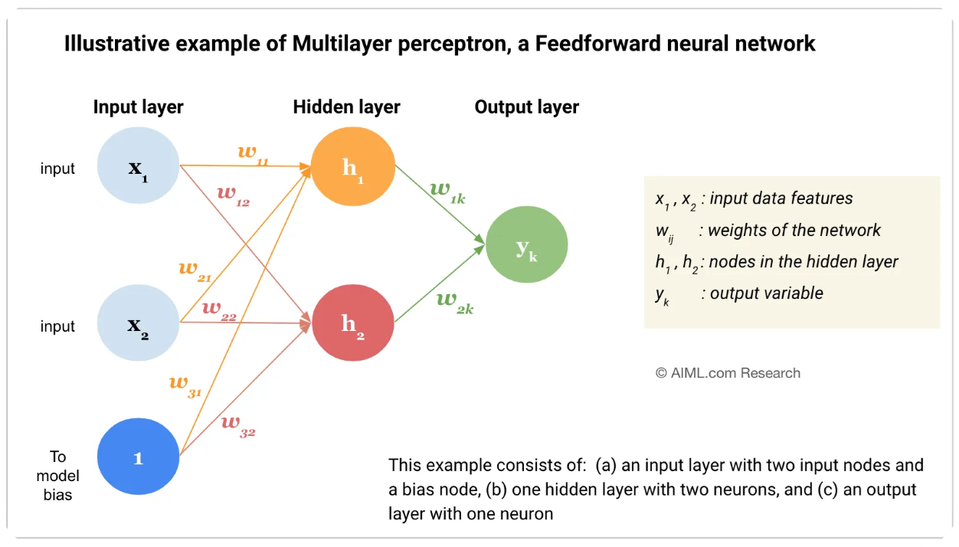

Slide 39
Key components of MLP
Input Layer
Weighted Connection and Biases
Hidden Layers
Activation Function
Forward Propagation
Output Layer
Backpropagation and learning
Iteration and Convergence

Slide 40
Input Layer
The process starts with the input layer, which receives the input data. Each neuron in this layer represents a feature of the input data.

Slide 41
Weighted Connections and Biases
Connections between neurons have associated weights, which are learned during the training process.
These weights determine the strength of the connections and play a crucial role in the network's ability to capture patterns in the data.
In addition, each neuron, in the hidden and output layers has an associated bias term, which allows for fine-tuning and shifting the activation functionʼs threshold.
These weights and biases are parameters that the neural network learns during training.

Slide 42
Hidden Layers
After the input layer, there are one or more hidden layers.
The neurons in these layers perform computations on the inputs.
The output of each neuron is calculated by applying a weighted sum of its inputs (from the previous layer), adding a bias, and then passing this sum through an activation function.

Slide 43
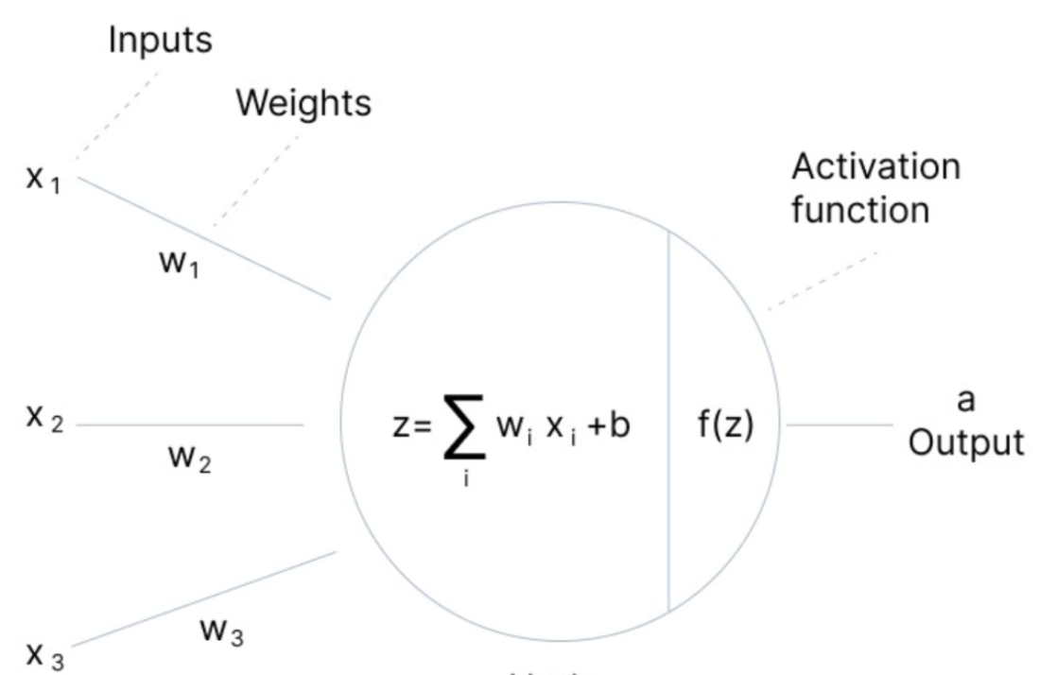

Slide 44
Activation Function
The activation function is crucial as it introduces non-linearity into the model,
allowing it to learn more complex patterns.
Common activation functions include sigmoid, tanh, and ReLU (Rectified Linear Unit).

Slide 45
Forward Propagation
The process from the input layer through the hidden layers to the output layer is called forward propagation.
In each layer, the aforementioned steps (weighted sum, bias addition, activation function) are applied to compute the layer’s output.
In an MLP, information flows in one direction, from the input layer through the hidden layers to the output layer.
There are no feedback loops or recurrent connections, hence the name feedforward architecture.

Slide 46
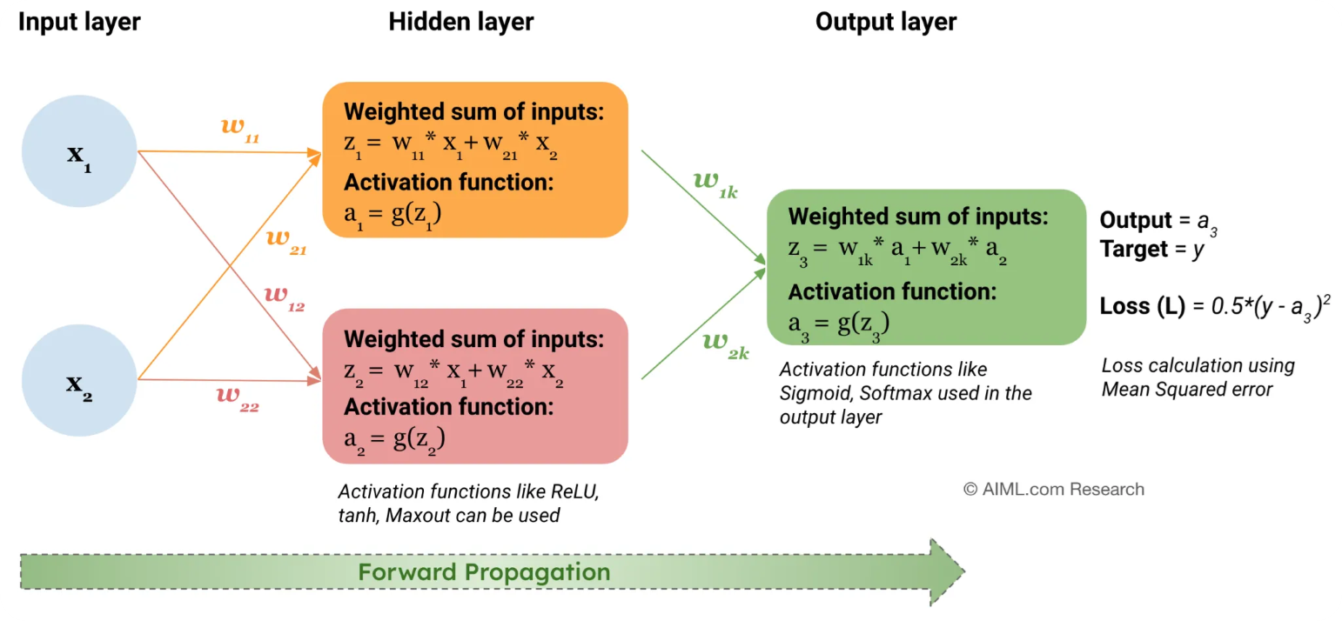

Slide 47
Output Layer
The final layer is the output layer.
In a classification task, this layer often uses a softmax function if the task is multi-class classification, or a sigmoid function for binary classification.
For regression tasks, no activation function might be applied in the output layer.

Slide 48
Backpropagation and Learning
Once a forward pass through the network is completed, the output is compared to the true value to calculate the error.
The error is then propagated back through the network (backpropagation), adjusting the weights and biases to minimize the error.
Backpropagation is typically done using optimization algorithms, such as stochastic gradient descent (SGD) and its variants.

Slide 49
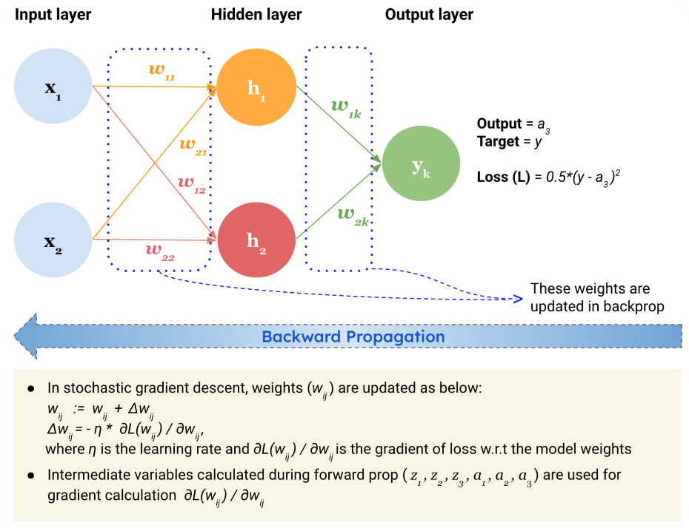

Slide 50
Iteration and Convergence
The process of forward propagation, error calculation, backpropagation, and parameter update is repeated for many iterations over the training data.
Gradually, the network learns to reduce the error, and the weights and biases converge to values that make the network capable of making accurate predictions or approximations.

Slide 51
Applications of MLP
Classification
Regression
NLP Tasks
Anomaly Detection
Speech Recognition
Computer Vision
Data Analytics

Slide 52
Source
https://aiml.com/what-is-a-multilayer-perceptron-mlp/

Slide 53
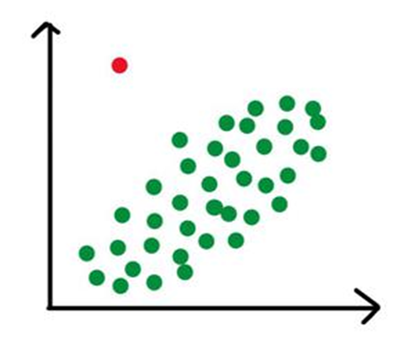
What are outlier?
Outliers are data points that significantly differ from other observations in a dataset, appearing as unusually high or low values that don't follow the general pattern

Slide 54
What are outlier?
They can be caused by measurement or execution errors
Outlier analysis or outlier mining
An outlier cannot be termed as a noise or error.
Outliers can skew results, but they can also highlight fraud (finance), critical patient conditions (healthcare), or new discoveries.
IQR Method: Points beyond \(Q3+1.5\times IQR\) or \(Q1-1.5\times IQR\) are outliers.
Z-Score: Points far from the mean (e.g., >3 or < -3 standard deviations).

Slide 55
Why Outliers Occur?
Data Entry Errors
Measurement Errors
Experimental Errors
Intentional Outliers
Data Processing Errors
Natural Variation

Slide 56
Why Removing Outliers is Necessary?
Impact On Analysis
Outliers can heavily distort statistical measures like the mean, variance and correlation leading to biased or misleading results.
Removing extreme values helps the analysis represent the central trend and typical behavior of the dataset more accurately.

Slide 57
Why Removing Outliers Is Necessary?
Statistical Validity
Outliers can weaken the reliability of hypothesis testing and reduce the performance of predictive models.
Proper handling of outliers improves model stability, accuracy and the trustworthiness of statistical conclusions.

Slide 58
Why Removing Outliers Is Necessary?
Model Performance and Interpretability
Outliers may cause machine learning models to overfit or learn incorrect patterns from rare extreme values.
Eliminating irrelevant outliers makes models easier to interpret and enhances their generalization to new data.

Slide 59
Outliers Identification using Statistical Methods
Statistical methods identify outliers by measuring how far data points deviate from the overall distribution using mathematical thresholds.

Slide 60
Types of outliers
Global (or Point) Outliers
Collective Outliers
Contextual (or Conditional) Outliers

Slide 61

What is Global Outliers?
Global outliers are data points that deviate significantly from the overall distribution of a dataset.
Errors in data collection, measurement errors, or truly unusual events can result in global outliers.
Techniques include statistical methods (e.g., z-score, Mahalanobis distance), machine learning algorithms (e.g., isolation forest, one-class SVM), and data visualization techniques.

Slide 62
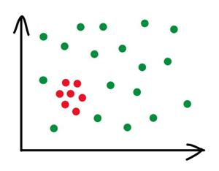
Collective Outliers
Collective outliers are groups of data points that collectively deviate significantly from the overall distribution of a dataset.
Collective outliers may not be outliers when considered individually, but as a group, they exhibit unusual behavior.
Techniques for detecting collective outliers include clustering algorithms, density-based methods, and subspace-based approaches

Slide 63
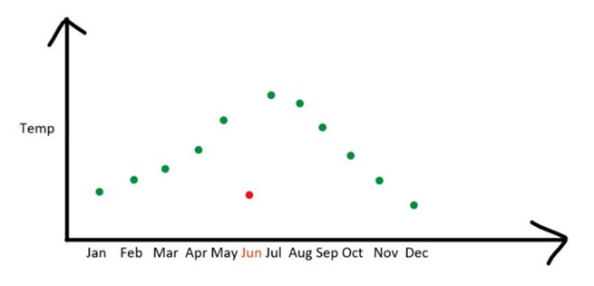
Contextual Outliers
Contextual outliers are data points that deviate significantly from the expected behavior within a specific context or subgroup.
Techniques for detecting contextual outliers include contextual clustering, contextual anomaly detection, and context-aware machine learning approaches.
Contextual information such as time, location, or other relevant factors are crucial in identifying contextual outliers.

Slide 64
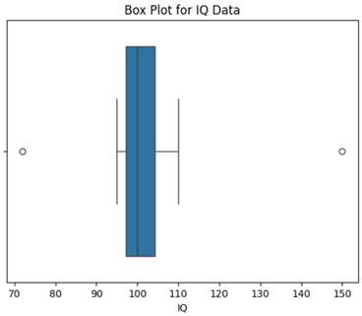
Box Plots
Box plots visually summarize the distribution of a dataset using the median, quartiles and interquartile range (IQR).
Any data points lying beyond the whiskers typically defined as 1.5 times the IQR from the first or third quartile are considered potential outliers.
The box plot shows outliers as points beyond the whiskers, with 72 and 150 indicating unusually low and high IQ values.

Slide 65
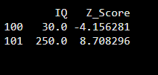
Z-Score
The Z-score method measures how many standard deviations a data point is from the mean of the dataset.
Values with Z-scores greater than +3 or less than −3 are commonly treated as outliers making this approach suitable for normally distributed data.
The output shows that IQ values 30 and 250 lie far from the mean with Z-scores beyond ±3.
This indicates they are extreme outliers significantly different from the rest of the data.

Slide 66
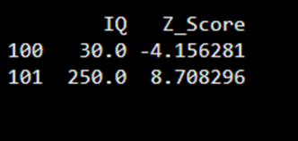
IQR Method
The IQR method defines outliers as values that fall below Q1 − 1.5 × IQR or above Q3 + 1.5 × IQR. Since it does not assume a normal distribution this technique is robust and widely used in real-world datasets.

Slide 67
How to handle Outliers in data?
Removal (Trimming)
Caping or Flooring (Quantile-Based Treatment)
Mean/Median Imputation
Transformation

Slide 68
When to Drop of Keep Outliers

Slide 69
When you should drop outliers
When the values is clearly incorrect
When you have a large dataset
When verification is possible

Slide 70
When you should not drop outliers
When results are critical or high-risk
When many outliers are present
When outliers represent real phenomena

Slide 71
What is Dimension Reduction?
Dimension Reduction in machine learning is the process of reducing the number of features (variables) in a dataset while preserving its most important information, transforming high-dimensional data into a lower-dimensional space to simplify models, improve performance, reduce noise, speed up computation, and enable better data visualization, tackling issues like the curse of dimensionality.

Slide 72
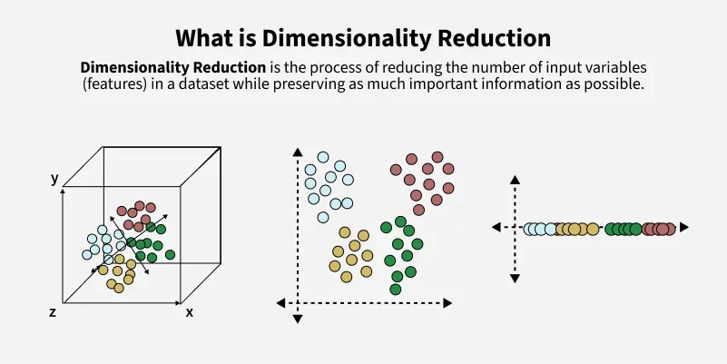
Dimensionality Reduction

Slide 73
Key Goals and Benefits of Dimensionality Reduction
Reduces Complexity: Makes large, complex datasets more manageable.
Prevents Overfitting: Fewer features lead to simpler models less prone to memorizing noise.
Improves Performance: Faster training and inference times for algorithms.
Enhances Visualization: Allows complex data to be plotted in 2D or 3D.
Reduces Storage: Less data means lower memory and storage requirements.

Slide 74
Common Approaches of Dimensionality Reduction
Feature Selection: Choosing a subset of the original features.
Feature Extraction: Creating new, fewer features (dimensions) that capture the essence of the old ones, like PCA (Principal Component Analysis) or t-SNE.

Slide 75
Dimensionality Reduction Techniques
Principal Component Analysis (PCA)
Linear Discriminant Analysis (LDA)
t-Distributed Stochastic Neighbor Embedding (t-SNE)
Independent Component Analysis (ICA)
Non negative Matrix Factorization (NMF)
FastICA

Slide 76
Dimensionality Reduction Techniques Cont..
Isomap(Isometric Mapping)
Locally Linear Embedding (LLE)
Manifold Learning
Autoencoders
Multidimensional Scaling (MDS)

Slide 77
What is variance?
variance measures how much a model's predictions change when trained on different subsets of data
high variance means the model is overly sensitive, learning noise and details (overfitting) rather than general patterns, leading to poor performance on new data,
while low variance indicates better generalization.

Slide 78
Variance Cont..
High Variance (Overfitting)
Definition: The model learns the training data too well, including random noise and irrelevant details.
Symptoms: Excellent performance on training data but poor performance (high error) on unseen test data.
Causes: Overly complex models (deep trees, neural networks), too many features, or insufficient training data.
Analogy: A squiggly line that hits every single training point perfectly but doesn't represent the true underlying trend.

Slide 79
Variance Cont..
Low Variance (Good Generalization)
Definition: The model's predictions are consistent across different training sets.
Symptoms: Good performance on both training and test data.
Causes: Simpler models or effective regularization.

Slide 80
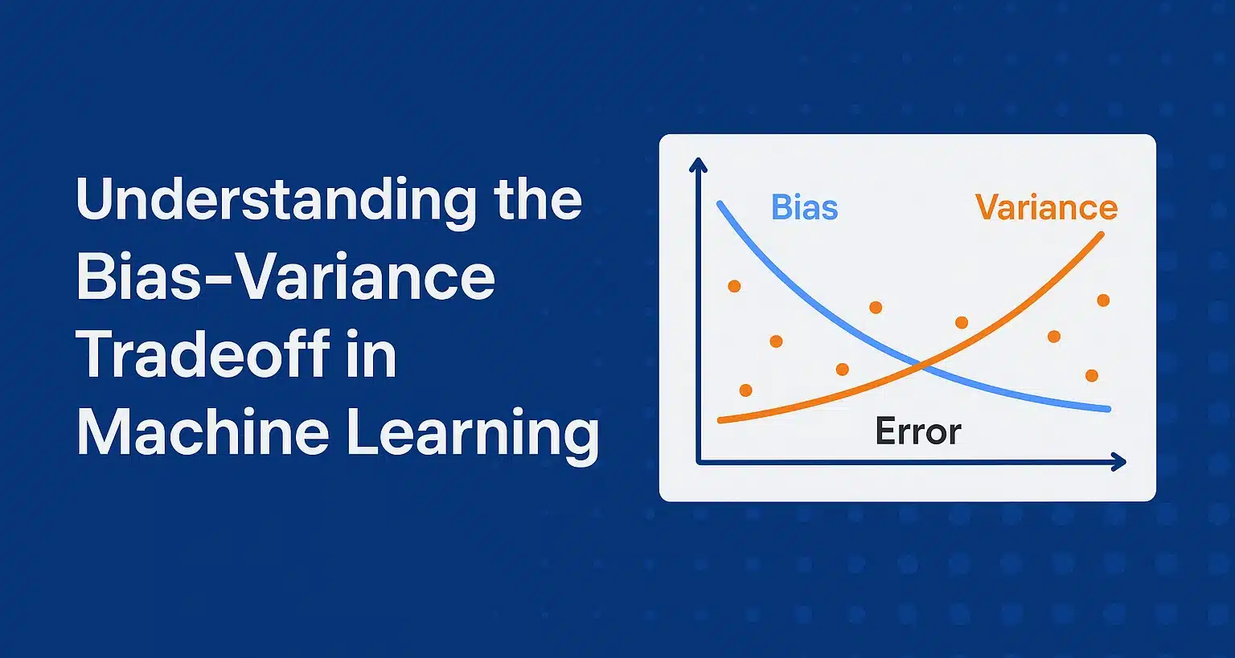
Bias Vs Variance

Slide 81
Explain Variance
Explained variance is a measure of how much of the total variance in the original dataset is explained by each principal component.
The explained variance of a principal component is equal to the eigenvalue associated with that component.

Slide 82
Explained Variance Ratio
Explained variance ratio is a measure of the proportion of the total variance in the original dataset that is explained by each principal component.
The explained variance ratio of a principal component is equal to the ratio of its eigenvalue to the sum of the eigenvalues of all the principal components.

Slide 83
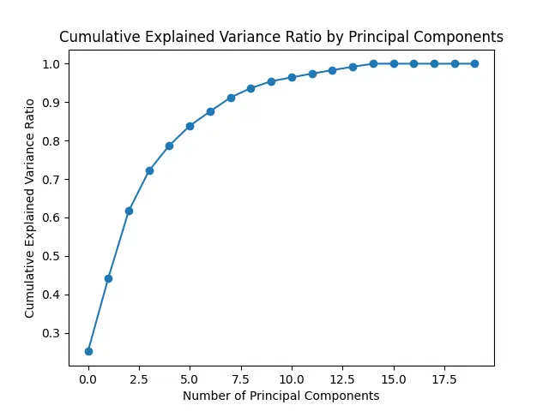
Cumulative Explained Variance
The plot above illustrates the cumulative explained variance ratio by the number of principal components. Each point on the curve represents the cumulative proportion of total variance explained as we incrementally add principal components. This visualization can help in determining the optimal number of principal components to retain, balancing the goal of dimensionality reduction with preserving a sufficient amount of information from the original dataset.

Slide 84
What is Confusion Matrix?
A Confusion Matrix is a table used to evaluate the performance of a classification model.
 | Predicted: Positive | Predicted: Negative
Actual: Positive | True Positive (TP) | False Negative (FN)
Actual: Negative | False Positive (FP) | True Negative (TN)

Slide 85
False Positive (FP): You predicted positive, but it was negative. Also known as a Type I Error or a "False Alarm."
False Negative (FN): You predicted negative, but it was positive. Also known as a Type II Error or a "Miss."

Slide 86
What is Recurrent Neural Network?
An RNN (Recurrent Neural Network) is a type of deep learning model designed for sequential data, like text or time series, that uses internal memory (a "hidden state") to process inputs by considering past information, allowing it to understand context and dependencies within a sequence to make predictions, such as in language translation or speech recognition.

Slide 87
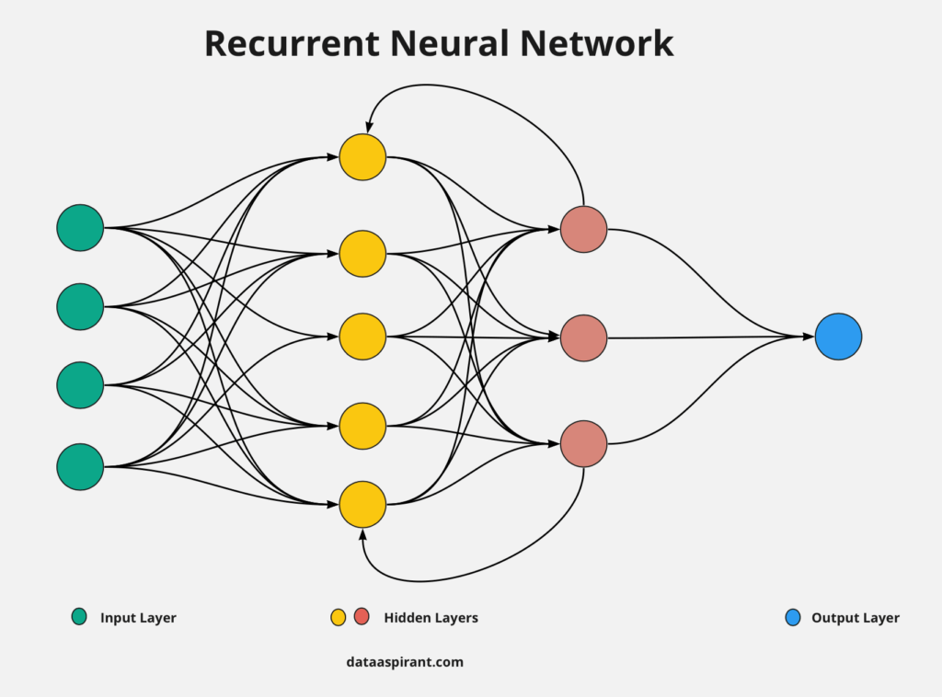
Recurrent Neural Network

Slide 88
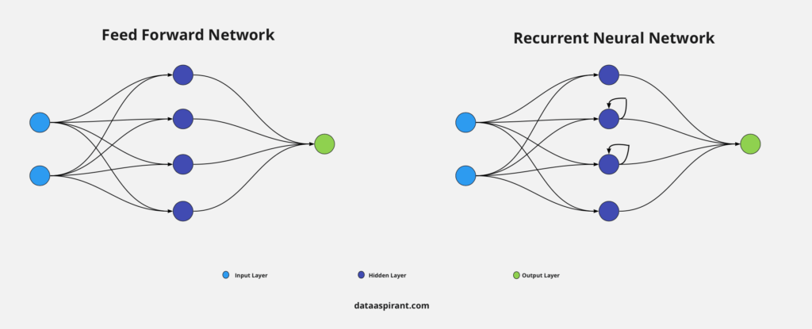
Recurrent Neural Network

Slide 89
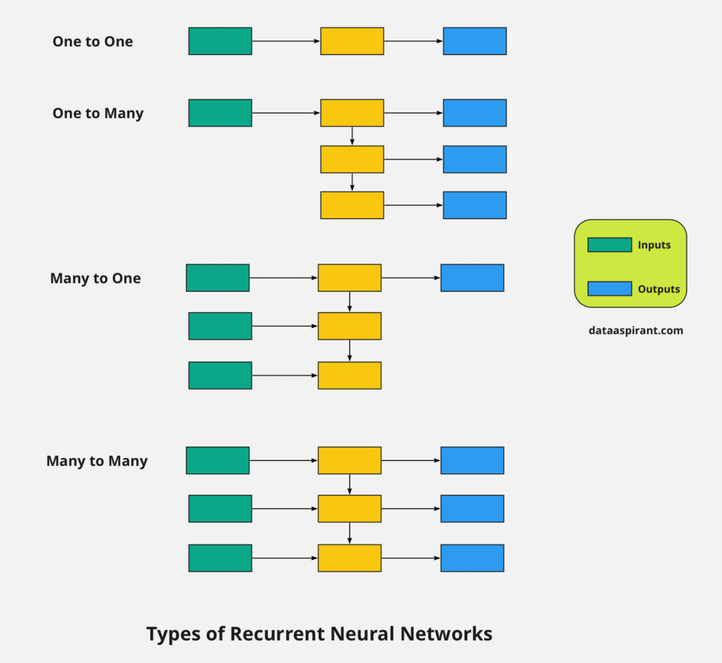
Types of Recurrent Neural Network

Slide 90
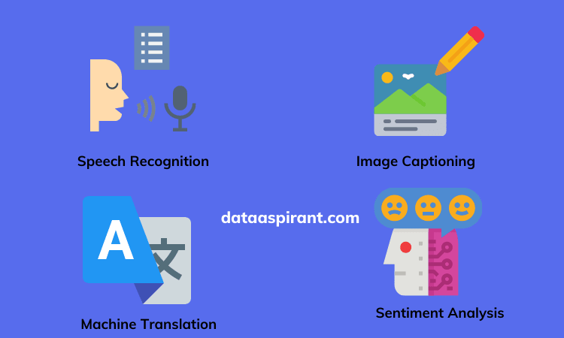
Recurrent Network Applications

Slide 91
What is LSTM?
Long Short-Term Memory (LSTM) is an enhanced version of the Recurrent Neural Network (RNN)
designed by Hochreiter and Schmidhuber.
LSTMs can capture long-term dependencies in sequential data making them ideal for tasks like language translation, speech recognition and time series forecasting.
LSTMs introduce a memory cell that holds information over extended periods addressing the challenge of learning long-term dependencies.

Slide 92
LSTM Architecutre

